Slide 1
Olympic Games: Cheating

Slide 2
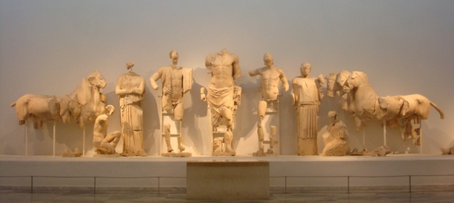
Temple of Zeus at Olympia: East Pediment
Pelops Zeus Oinomaos
F I H G K

Slide 3
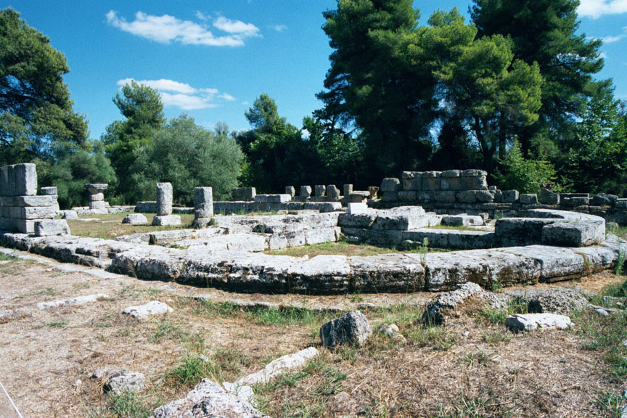
“But the Zeus in the Council Chamber is of all the images of Zeus the one most likely to strike terror into the hearts of sinners. He is surnamed Oath-god, and in each hand he holds a thunderbolt. Beside this image it is the custom for athletes … to swear an oath upon slices of boar’s flesh that in nothing will they sin against the Olympic games.”
Pausanias V.24.9

Slide 4
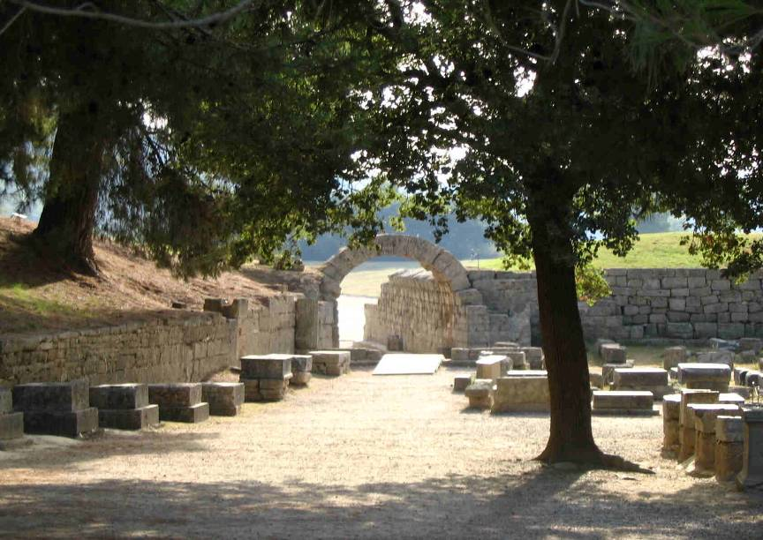

Slide 5
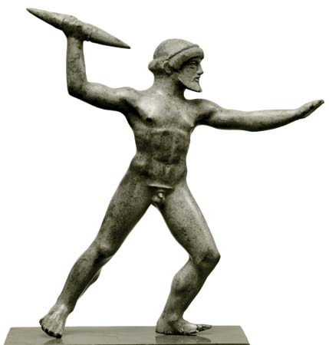
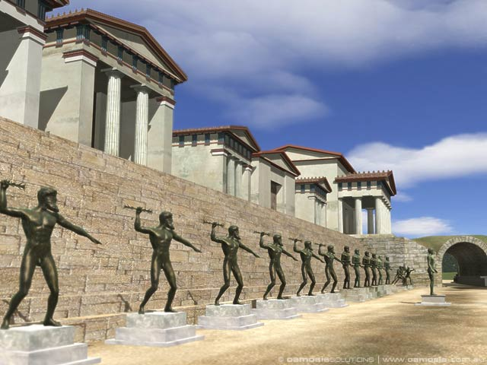
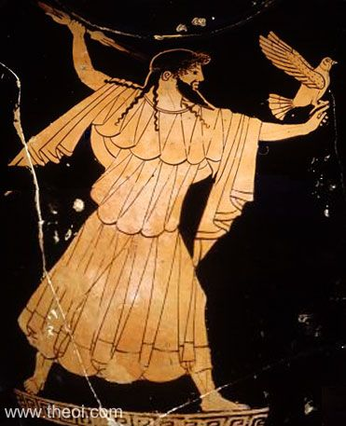

Slide 6
How did your athlete cheat?

